Slide 1



Sentiment analysis of historical text
Anne Frank Diary of Young Girl
Img Src

Slide 2

The Diary of Anne Frank
Sentiment analysis applied to historical documents helps us in peeling off the layers of cultural background in a novel way.
Anne Frank, a young girl residing in the Netherlands, got a diary as her 13th birthday gift on 12th June 1942 while hiding in a secret annex. she wrote her diary for 2 years in a period from July 1942 to July 1944. She died in the Holocaust when she was 15 years old. Her father published her diary in 1947 two years after the war ended.
Anne Frank’s diary gives us access to the inner world of a young Jewish girl – her fears, thoughts and dreams that were set against the greatest tragedy the world has ever gone through – the World War II. Anne Frank's diary appeared to be an incredibly personal narrative— a tiny sparrow making an attempt to sing under the storm.
The emphasis of the research is on Anne Frank's emotional diary, which is an important historical document that presents us with a penetrating and vivid impression of that turbulent time.
Img src

Slide 3
Exploring Emotional Depths with Natural Language Processing
Synthesis of historical texts by NLP, as shown in Anne Frank's diary, brings out amazing information about the history of mankind. Anne's diary, a witness to her emotional journey, revealed her inner conflict. NLP algorithms along with the NRC Emotion Lexicon help to elucidate Anne's inner emotions and Streamlit shows us her courage and pivotal moments. Anne's transcendent strength is what is left that will contribute to the improvement of cultural traditions and development of cultural identity.

Slide 4
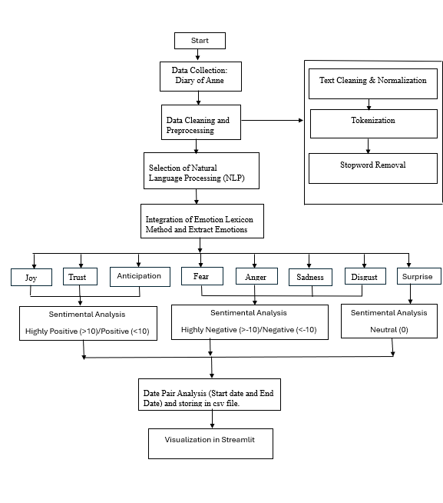
Methodology for Sentiment Analysis and Emotion Extraction
Data Collection: Obtaining Anne's Frank's diary entries.
Text Preprocessing: Processing and formatting of text data for the analysis.
NRC Emotion Lexicon Loading: Loaded the NRC Emotion Lexicon in which the words are marked with the emotions and sentiments rating.
Sentiment Score Calculation and Labeling: The difference between the positive and negative emotions can be measured. Thus, this helps in calculating the sentiment scores and you can place them in clearly predefined categories.
Date Pair Analysis: Pick the date-entries in the diary text to know the sentiments and emotions trends over time.
CSV Data Export: Save extracted emotions and sentiment scores along with the date entries in a CSV file for further analysis.
Visualizing the extracted data in Streamlit

Slide 5
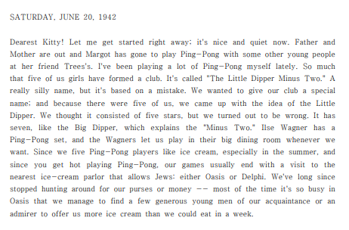
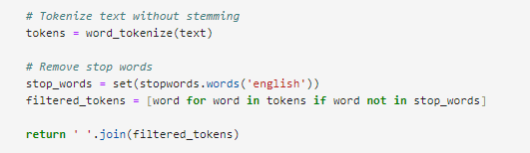
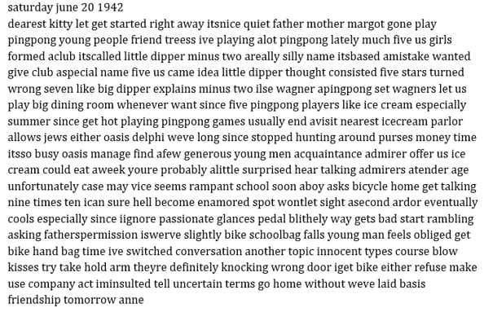
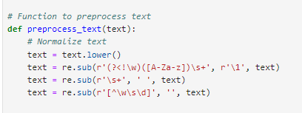
Preprocessing and Data Cleaning
Before:
The text preprocessing stage focuses on eliminating unnecessary characters and symbols, removing non-linguistic content such as numbers, text tokenized into discrete words and filtering out stop words to facilitate meaningful analysis.
Text Preprocessing:
After:
Text tokenization and filtering stop words:

Slide 6
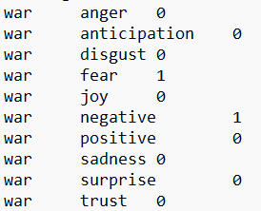
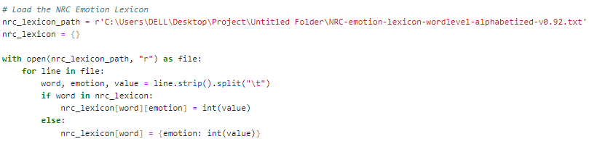
NRC Emotion Lexicon Loading
The second step involves bringing to the limelight the NRC Emotion Lexicon which is a meticulously designed lexicon consisting of emotion labeled words that have sentiment ratings.
The word 'war' taken from the NRC Emotion Lexicon. While the term 'war' is typically considered a negative word with the emotion of fear therefore receiving a sentimental score of 1 for fear and 0 for the other emotions.

Slide 7
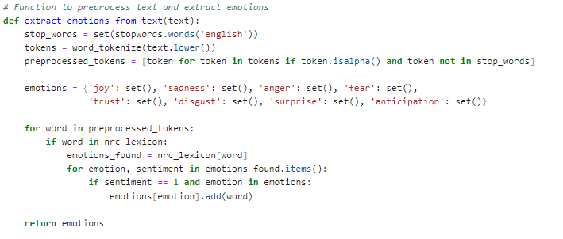
Emotion Extraction
Code Snippet:
The code checks word appearing in text from NRC Emotion Lexicon. Once a match is found, the term is linked to the lexicon's definition of the category of emotions represented by those feelings(sadness," "anger," "fear," "joy," "trust," "disgust," "surprise," and "anticipation).

Slide 8

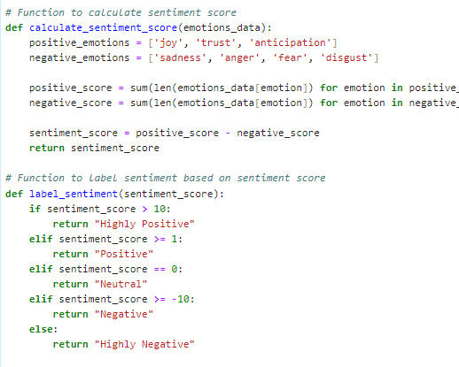
Sentiment Score Calculation and Labeling
The difference between the positive and negative emotions can be measured. Thus, this helps in calculating the sentiment scores .
Sentiment is intended to be labeled into discrete groups, such as highly positive, positive, neutral, negative, or highly negative, by using predetermined thresholds to enable classification.

Slide 9
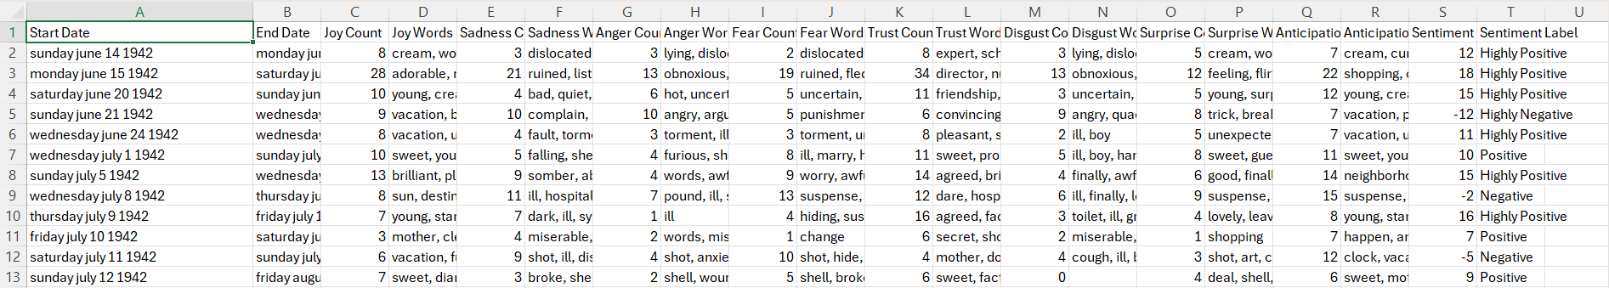
Date Pair Analysis and CSV Data Export
Pick the date-entries in the diary text to know the sentiments and emotions trends over time.
Save extracted emotions and sentiment scores along with the date entries in a CSV file for further analysis.

Slide 10


Visualization
With the help of Streamlit, created an online application for the emotional trends in Anne Frank's diary so that the users can analyze them. The program will show a real-time emotional counts, distribution of sentiment scores, word frequencies and the like by means of different charts, e.g., word clouds, pie charts, histograms, and line charts.
User can develop the code for Streamlit application by creating a Python script (.py file).
Click here for Streamlit App’s Link.

Slide 11
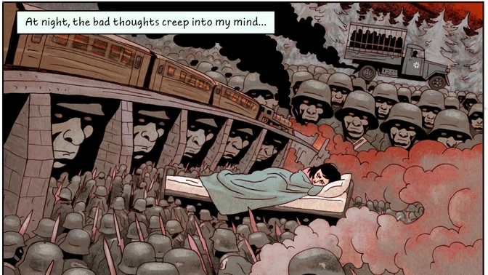
Conclusion
Examining Anne Frank's diary sentimentally brings out the way that a young girl was emotionally going through difficult times in history. By means of close reading and visualizing, we find her emotion changes from complete depression to little episodes of optimism. The study adds depth to our knowledge of Anne's survival and resilience and provides insights into the human experience amid genocide.
Img Src

Slide 12
Future Consideration
To enhance the sentiment analysis our possible solutions could evaluate the exiting models, discover cutting-edge NLP strategies like deep learning models and provide extra lexicons or resources to cover all the emotions to the maximum. Develop a specific improvement plan that involves a sequence of data preprocessing, training models and evaluation of the performance. Invite feedback from experts to validate steps and also make iterations to the process as per the feedback. For the sake of the democracy and openness think to make your decision public and spread information.

Slide 13

Thank you, Anne Frank, for sharing your story and inspiring countless generations with your courage, resilience, and enduring spirit.
June 12, 1929 - March 1945
Img Src

